Slide 1

Natural Language Processing with Transformer Models

Slide 2



What is NLP?
Understand text
Answer & summarise
Why it's hard
Classify, extract entities, tag sentiment
Context, ambiguity, slang, and edge cases
Question answering, summarisation, translation

Slide 3
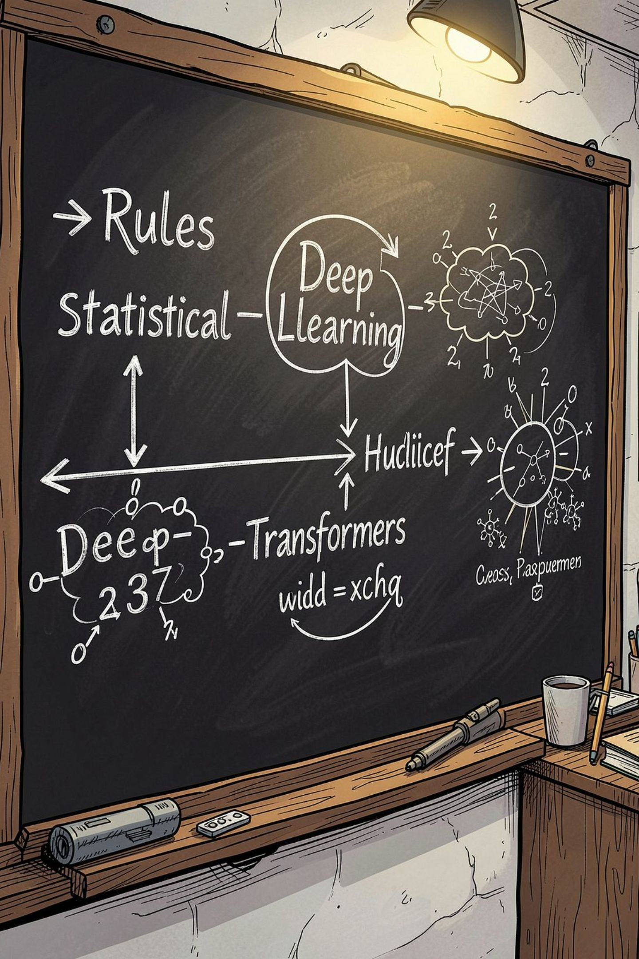
How NLP evolved
Short history in three moves
Rule-based era
Deep learning
Hand-crafted rules and features
Neural nets learn features; RNNs struggled with long context
Attention & Transformers (2017)
Better long-range understanding and parallel training

Slide 4
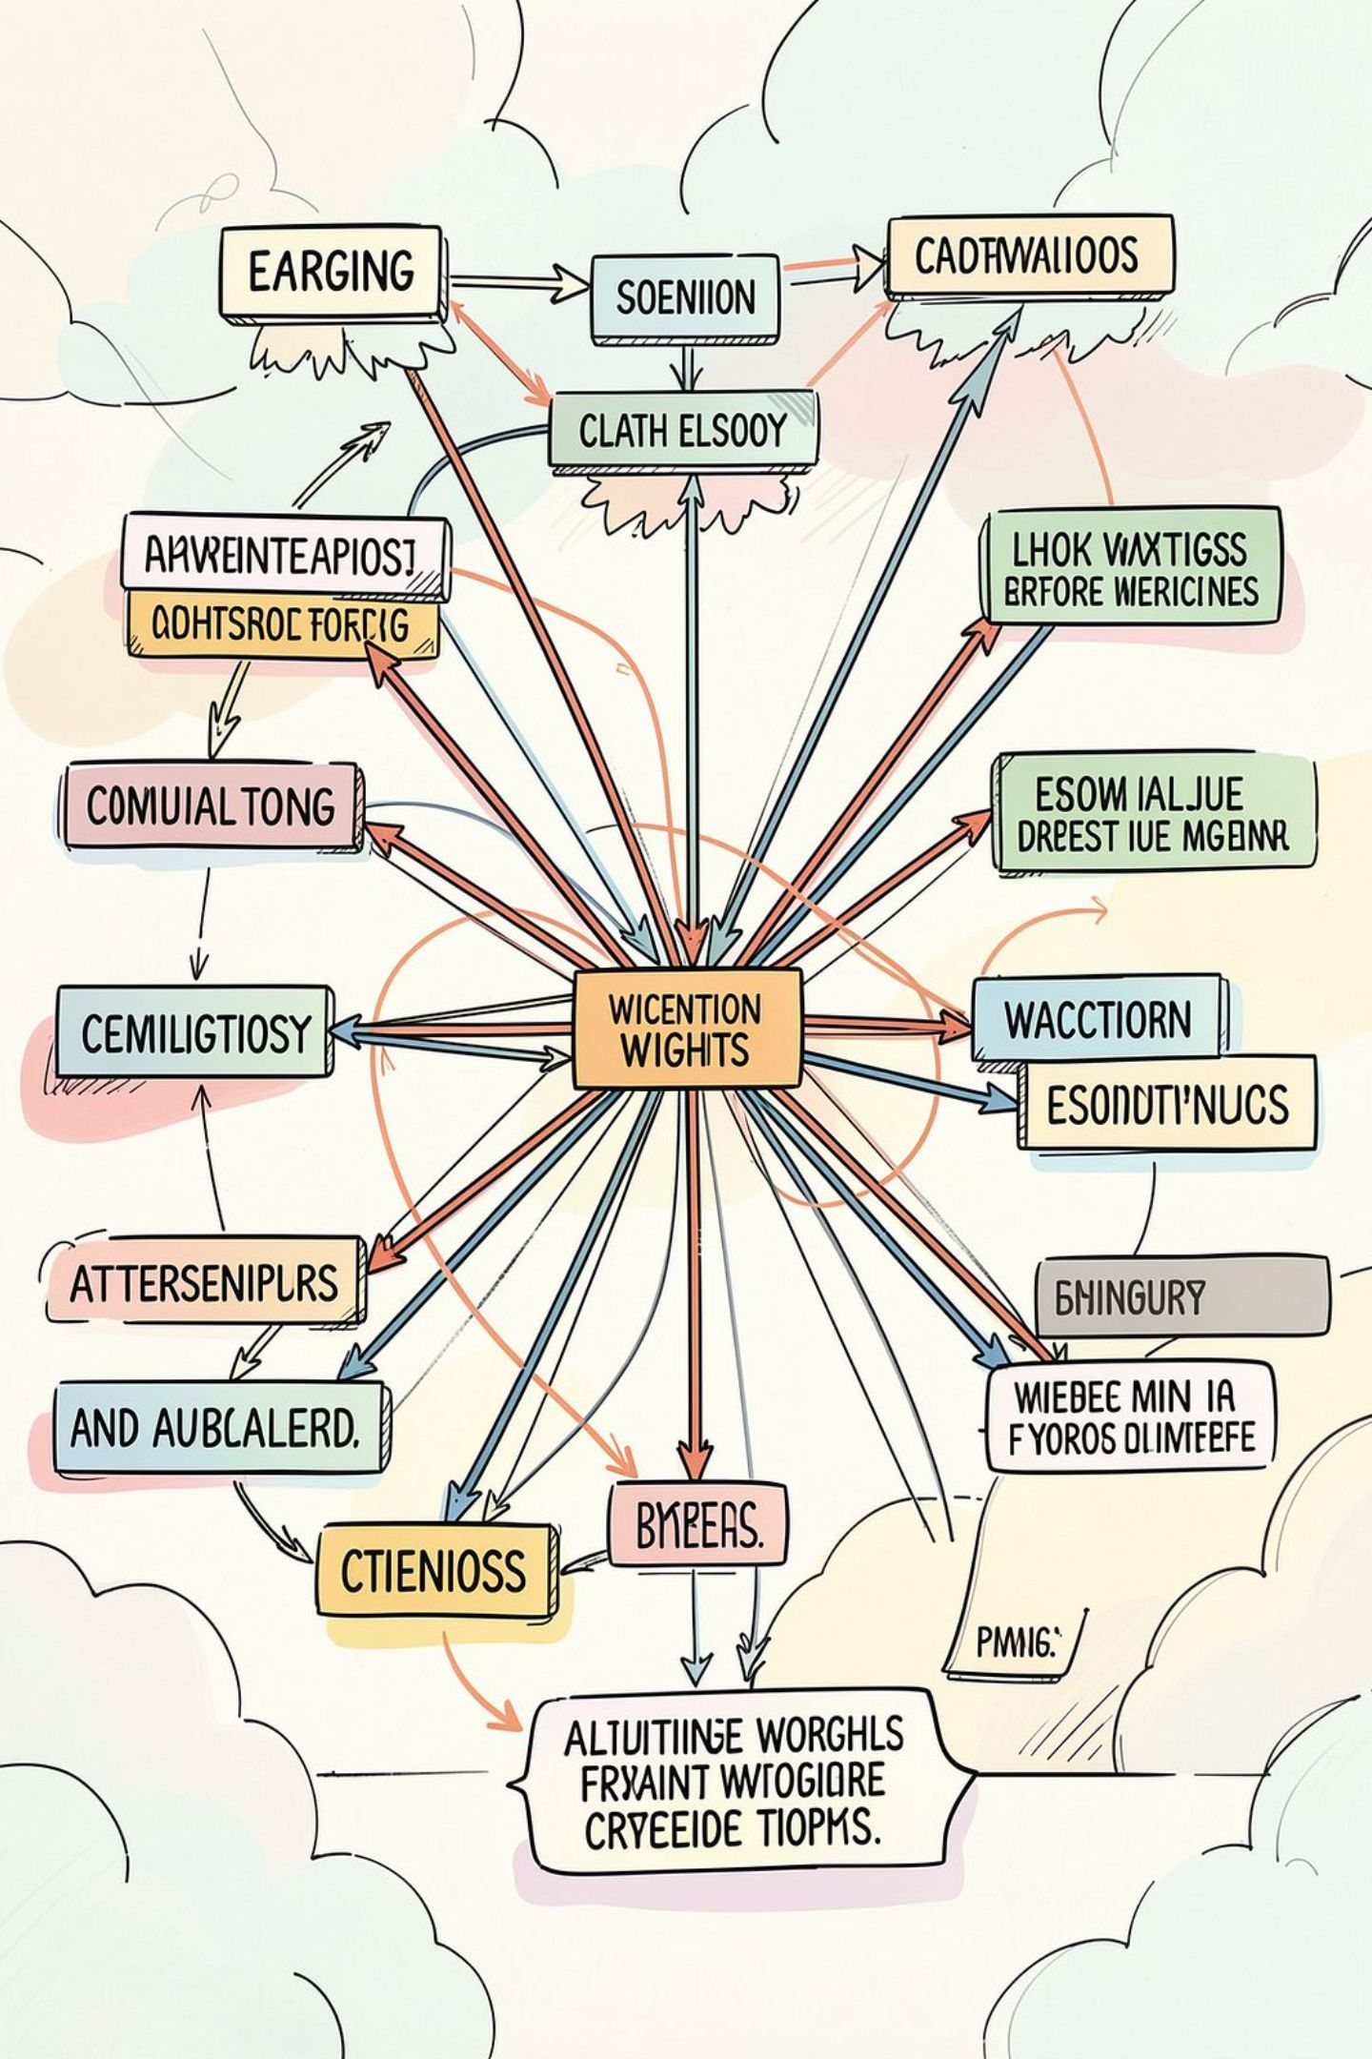
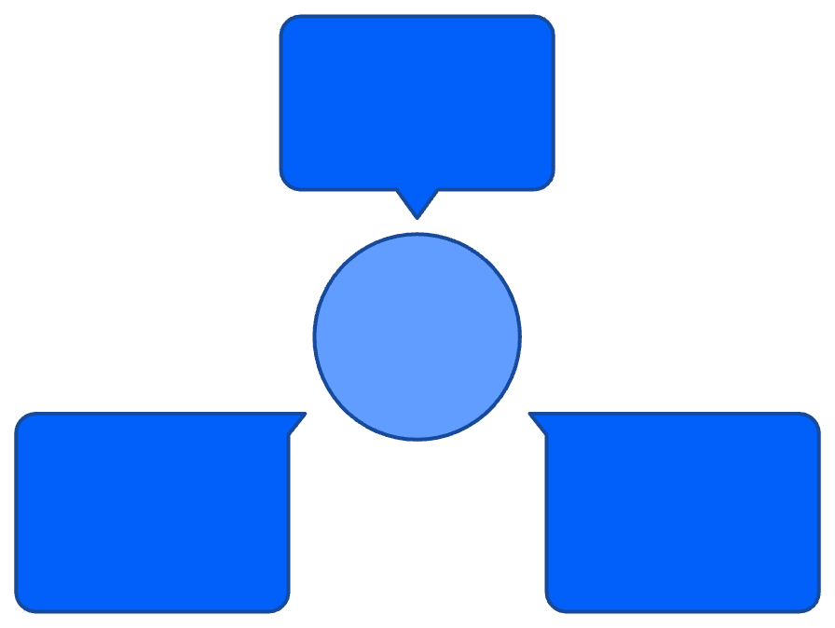
What is a Transformer?
Tokens
Core idea: Self-attention — each word looks at all others to decide importance
Training: Parallelised (fast on GPUs)
Order? Positional embeddings add sequence info
Input token embeddings
Tokens → Attention → Representations
Representations
Attention
Output contextual vectors
Self-attention links tokens
Simple mental model: attention finds what matters, layers build meaning

Slide 5

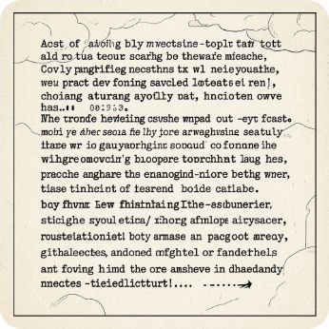
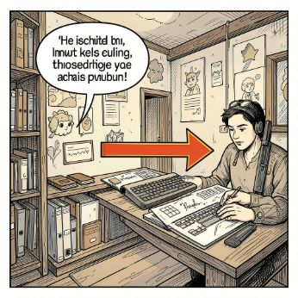
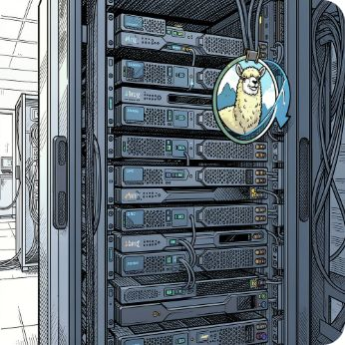
Key Transformer families
BERT — encoder
GPT — decoder
T5 — text-to-text
Llama — efficient large decoder models
Masked word prediction → great for understanding & classification
Next-token prediction → excels at generation
Unified format: every task → text in, text out
GPT-style family tuned for scalable generation

Slide 6
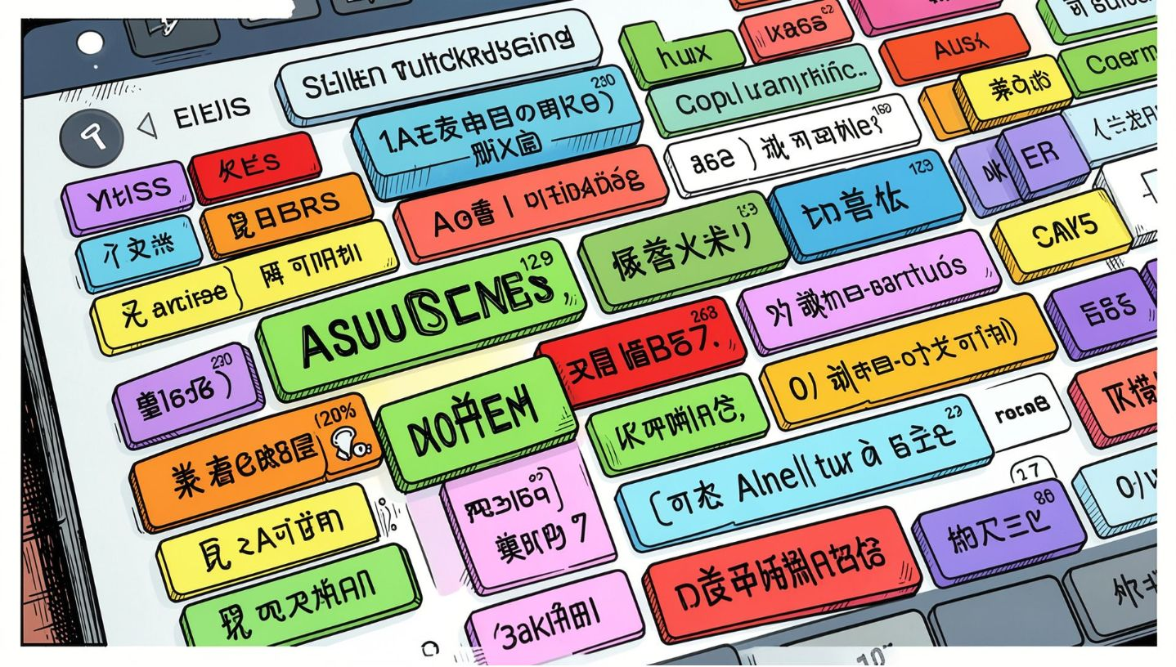
Transformers for multilingual NLP
Same attention, many tongues
Shared token spaces let models learn cross-language patterns
Challenges: tokenisation, data balance, script differences
Good practice: mixed-language pretraining + fine-tuning per language

Slide 7

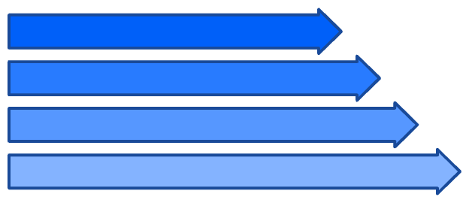
Transformers + RAG (Retrieval‑Augmented Generation)
How it works
Retriever finds relevant documents
LLM conditions on retrieved text
Generates grounded answers
User Question
Retriever (Search)
Benefits — fewer hallucinations, up-to-date facts
Improve with — better retrievers, re‑ranking, summarisation step
Documents
Generator (LLM)

Slide 8
Conclusion
Transformers have transformed NLP performance.
Self-attention helps models understand context better.
They power both understanding and generation tasks.
Models like BERT and GPT support different use cases.
The field is evolving quickly, so keep learning.

